Slide 1

Demand creation for HIV prevention:
A Look Back; A Look Ahead
Mitchell Warren, Executive Director, AVAC

Slide 2
conflict of interest
No conflicts of interest to declare.

Slide 3
who's our competition?

Slide 4
who's your competition?

Slide 5


Slide 6
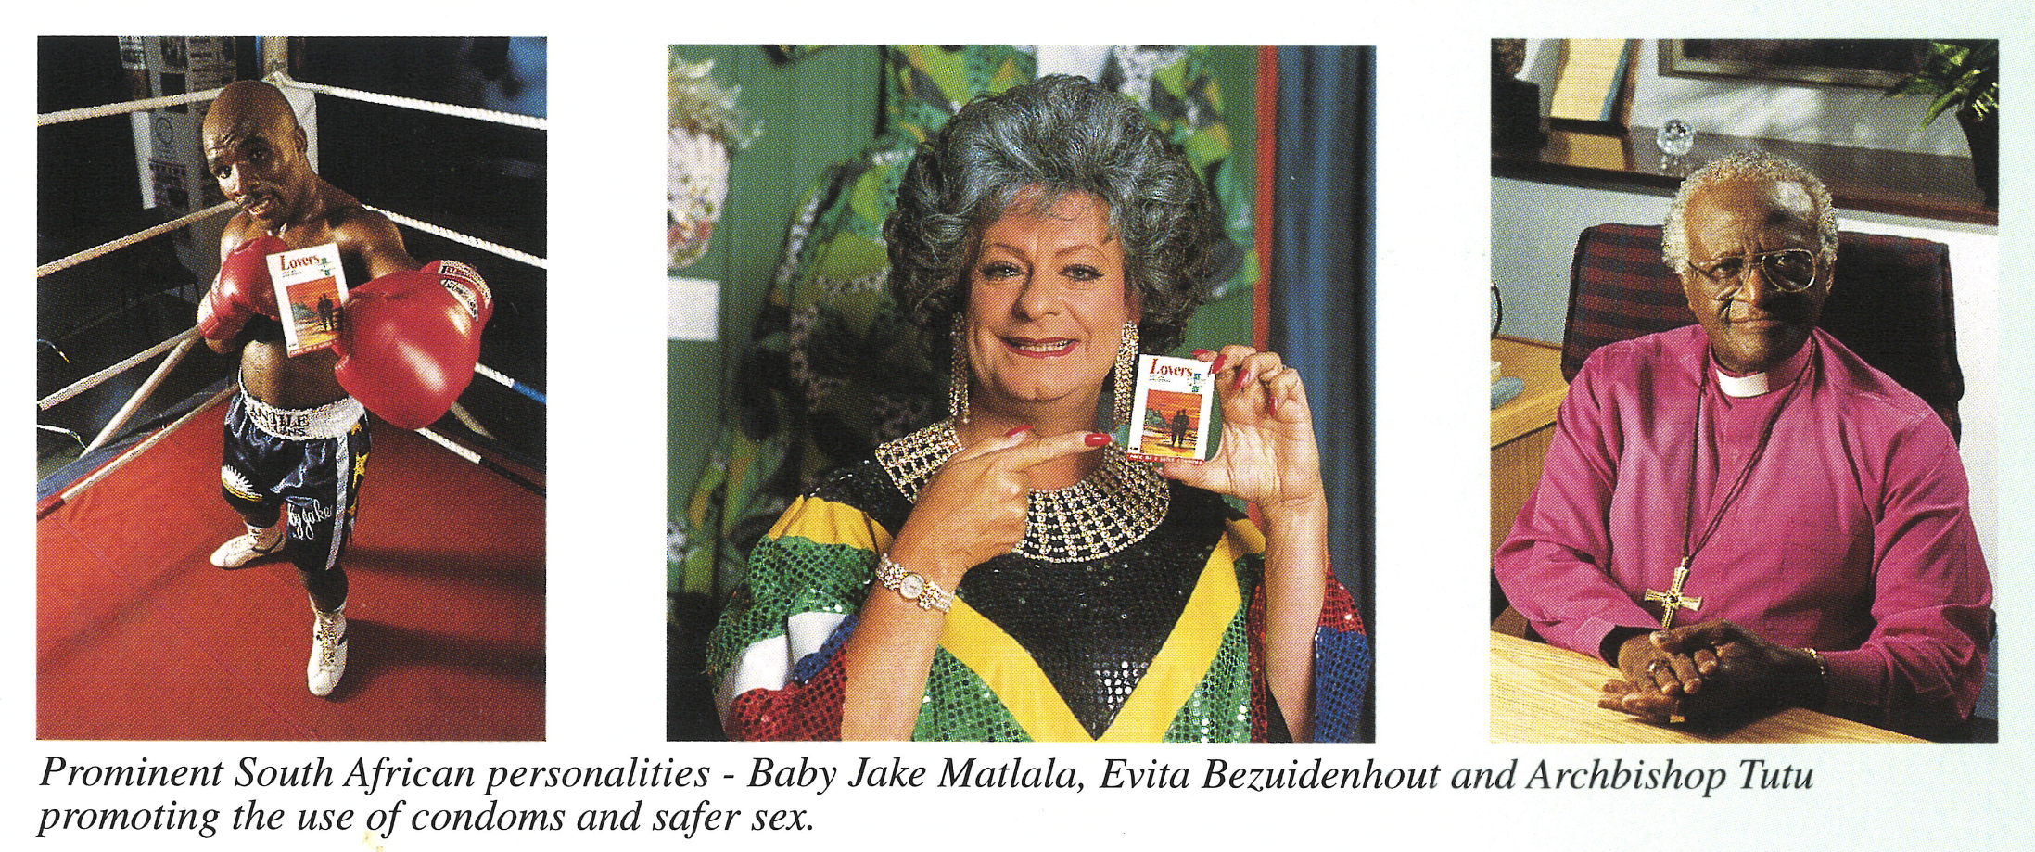
Rubber revolution

Slide 7
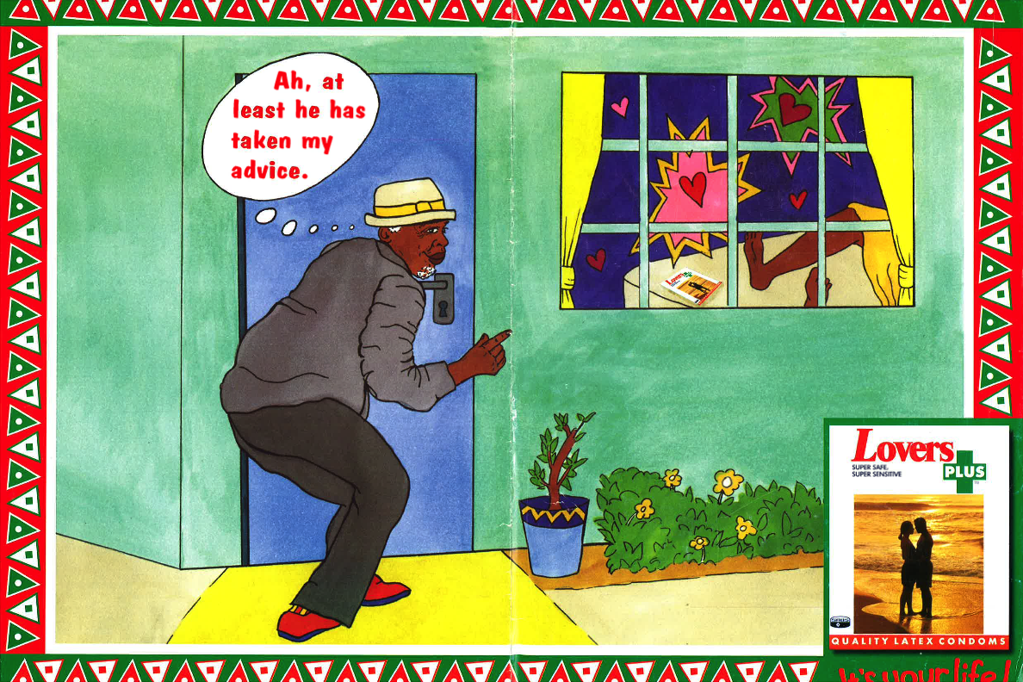

Slide 8


Slide 9

Why use a condom?

Slide 10
If we build it, will theY come?

Slide 11
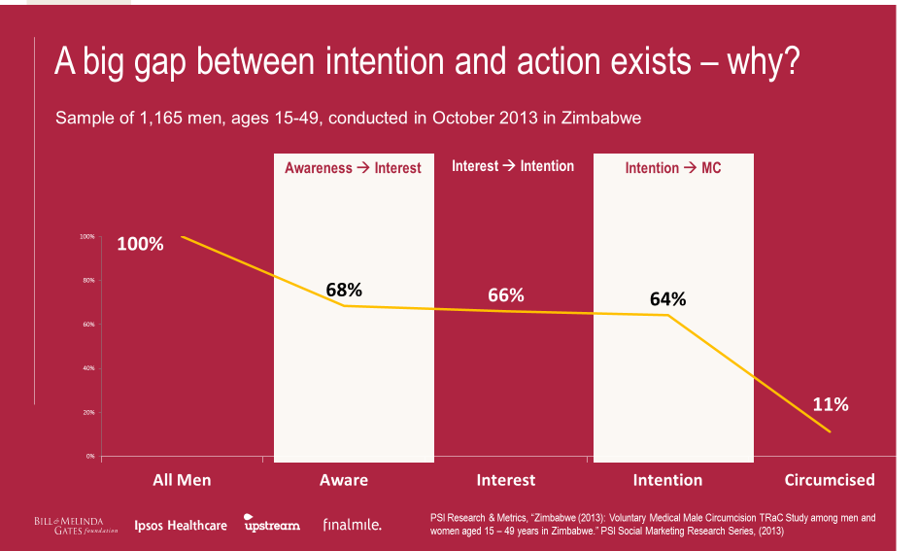
WhaT’s the problem?

Slide 12

What happened?
From:
VMMC works
Convince funders & policy makers
Build services
Understand culture
To:
VMMC might work for me
Convince men, & partners, peers, parents
Build demand
Understand men

Slide 13
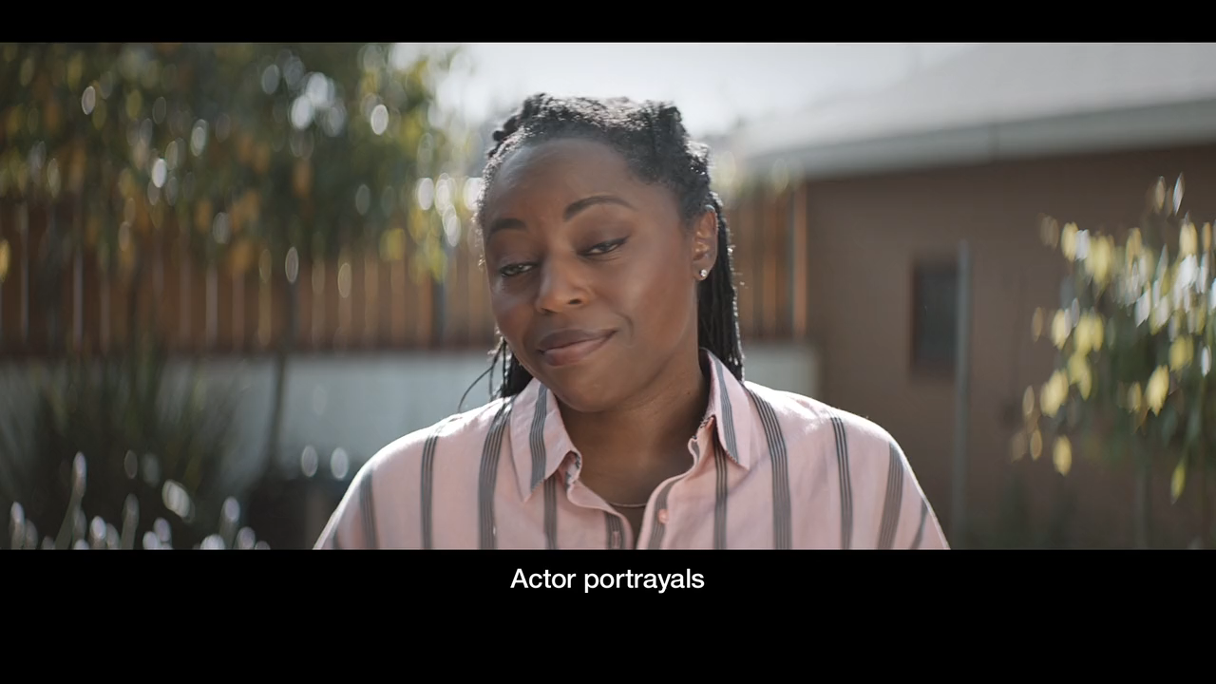
who uses prep? And why?

Slide 14
Past, present, future
Know your audience
Listen to your audience
Empower your audience
Invest as much – or more – in delivering your product/intervention as you did in developing it
Bottom line: It’s never just the product; it’s the program

Slide 15








acknowledgments
This program is made possible by the generous assistance from the American people through the U.S. Agency for International Development (USAID) in partnership with PEPFAR.
The contents do not necessarily reflect the views of USAID or the United States Government.

